Slide 1
How to find public records
My email: cj.ciaramella@gmail.com

Slide 2
Why bother with public records?
Records give you hard evidence.
What can you do with public records?
http://extras.mercurynews.com/policeguns/
https://wtop.com/virginia/2018/07/the-bachelorette-gets-536k-and-richmond-gets-a-rose/
https://www.dnainfo.com/new-york/20150422/bay-ridge/new-yorks-most-loud-sex-complaints-come-from-this-building-records-show

Slide 3
Where to find public information
Before you FOIA, look to see if the data is already available. Save yourself (and the government!) time and money.
FEC filings: http://www.fec.gov
Open Secrets: http://www.opensecrets.org
PACER: http://pacer.login.uscourts.gov
FBO: http://www.fbo.gov
The Federal Register: http://www.federalregister.gov
Sunlight Foundation: http://sunlightfoundation.com

Slide 4
Where to find public information
Deeper down the rabbit hole …
Foreign Agents Registration Act database
The FBI’s National Stolen Art File
The Treasury Department’s Justice Fund Payment Search

Slide 5
How to find non-publicly available records
Whenever the government creates a document, you have a presumptive right, thanks to the Freedom of Information Act and its state analogues, to see it, unless it’s specifically exempted by law.
You can ask a government agency to voluntarily hand over records (and sometimes they will!) but often, you’ll be forced to file a Freedom of Information request. Here comes the not-fun part ...

Slide 6
Resources for filing FOI requests
Reporters Committee for Freedom of the Press
Student Press Law Center
MuckRock
FOIAMapper
FOIA Wiki
Your FOI officer!

Slide 7
Three essential questions for FOI requests
What records do I want, specifically?
Timeframes, keywords, titles and form names are your friends.
Are the records I want exempt?
There are nine general exemptions to the federal FOIA, and they cover a lot of ground, from national security to trade secrets to “predecisional” communications.
The White House is largely exempt from FOIA, as is Congress. State laws vary.
Who has them?
Look for an Information Act page on the website, or call and ask who handles requests

Slide 8
Don’t be like James
Who filed this request to the NSA:

Slide 9
How I got Detroit PD dog shooting reports
https://www.muckrock.com/foi/detroit-314/detroit-pd-destruction-of-animal-reports-27649/
The results: Ta-da!

Slide 10
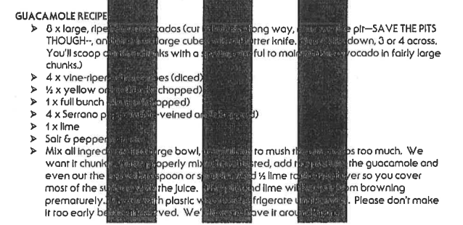
Bonus: Jack White’s guacamole recipe

Slide 11
Remember
When a private entity (or even a public one normally exempt from FOIA) interacts with a government agency and leaves a paper trail, those documents can be subject to public records requests. That includes:
Private citizens
Law enforcement records, complaints (e.g. Amtrak, Chipotle, Trump University, etc.)
You!
FOIA logs and communications with public affairs
Advocacy groups, non-profits, private contractors, etc.
Communications, applications, contracts, audits, etc.

Slide 12
Final tips
Know the law and regulations, because the government sure does.
Always appeal.
Find what works for someone else and copy it.
#FOIA

